Slide 1


SCIENCE RESEARCH ACTIVITY SUPPORT SYSTEM
Capstone Project - FPT University
SUPERVISORS
Kieu Trong Khanh
HCMC Campus, FPT University Research Department
MEMBERS
Hoang Thi Hoai Thuong
Mai Hoang Duong
Bui The Hien
Nguyen Dang Truong Anh
Le Thi Quynh Nhu (Dropout)

Slide 2

AGENDA
SCIENCE RESEARCH ACTIVITY SUPPORT SYSTEM
01
02
03
Introduction
Main Flows
Outcome

Slide 3

Software Introduction
The Science Research Activity Support System (SRASS), was designed to meet the specific requirements of the FPT University, Ho Chi Minh Campus's Research Department. Its primary purpose is to simplify scientific conference management, with the﻿ initial deployment taking place at the HCM Campus.

Slide 4

Conference Management (Scoping of FPT University)
Input Conference Plan
Configure Conference Preferences
Initiate a Call for Research Papers
Appoint Paper Reviewers
Finalize Paper Decisions
Communicate Decision Results
Request for Camera Readies
Request Presentation Materials
Produce Reports

Slide 5
General Procedure

Slide 6




INITIALIZE A PLANNED CONFERENCE
MONITOR AND MANAGE CONFERENCE SUBMISSIONS
Admin
System
Chairman
System
Authors
System
Chairman
1
Create
Notify
3
Configure
Change to [Open
Submit
Report
2
4
5
6
7
Conference
Conference
for Submission] phase
Paper
Assess Preliminary
System
15
Submit Revision
Authors
System
Chairman
System
Reviewers
System
Chairman
8
Notify
Make
Trigger
Submit
Trigger
Assign
Reviewers
Report
14
13
12
11
10
9
Email
Decision
Reviews
16
Report
PREPARE CONFERENCE PROCEEDING
Chairman
Authors
System
17
Request
18
Submit
Camera Ready
Camera Ready
19
Register
System
Chairman
Authors
System
Admin
20
Report
21
Request
22
Submit
23
Produce
for Presentation
Presentation
Report

Slide 7
Flow 1:
Initialize a Planned Conference

Slide 8
Flow 1: Initialize a Planned Conference
Initiating the conference includes tasks related to setting up a new conference and configuring the conference before the paper call phase begins.
Conference Management Tasks include
Create Conference
Configure Conference
INITIALIZE A PLANNED CONFERENCE
Admin
System
Chairman
System
1
Create
Notify
3
Configure
2
Conference
Conference

Slide 9

Student Research Competition
SCENARIO
From Oct 5, 2023 to Dec 24, 2023.
At FPT University, Ho Chi Minh Campus, Vietnam
With 4 tracks:
Information Technology
Business Administration
Linguistics
Graphic Design - Multimedia Communications
Conference Program Committee
Mr. Tran Tuan Anh: Chair
Dr. Dang Ngoc Minh Duc: Chair
Dr. Nguyen Tuan Cuong: [Information Technology] Track Chair
Dr. Le Thi My Danh: [Graphic Design - Multimedia Communications] Track Chair
Dr. Nguyen Thi Ai Thy: [Business Administration] Track Chair
Dr. Nguyen Hoang Bao Nguyen: [Linguistics] Track Chair
FPTU HCM Student Research Competition 2023 (FU HCM SRC 2023)
CREATE CONFERENCE

Slide 10
INITIALIZE A PLANNED CONFERENCE
MONITOR AND MANAGE CONFERENCE SUBMISSIONS
Admin
System
Chairman
System
Authors
System
Chairman
1
Create
Notify
3
Configure
Change to [Open
5
Submit
Report
2
4
6
7
Conference
Conference
for Submission] phase
Paper
Assess Preliminary
System
Authors
System
Chairman
System
Reviewers
System
Chairman
8
Notify
Make
Trigger
Submit
Trigger
Assign
Reviewers
Report
14
13
12
11
10
9
Email
Decision
Reviews
15
Report
PREPARE CONFERENCE PROCEEDING
Chairman
Authors
System
16
Request
17
Submit
Camera Ready
Camera Ready
18
Register
System
Chairman
Authors
System
Admin
19
Report
20
Request
21
Submit
22
Produce
for Presentation
Presentation
Report

Slide 11
Simulator
Important note:
This module is exclusively designed for simulation purposes during demos and system presentations. It is NOT integrated into actual systems.
The Simulator module comprises two primary functions:
It fine-tunes real-time system simulations to mimic the progression of conference stages into the future.
It includes sequential scripts that simulate input data for sequential system activities, synchronized with the conference's progress.

Slide 12
[Admin] Create Conference
INITIALIZE A PLANNED CONFERENCE
Admin
System
Chairman
System
Input Conference Plan
1
Create
Notify
3
Configure
2
Conference
Conference
Configure Conference Preferences
Admin receives the conference plan and uses the information on it to create a new conference to ensure its authenticity.
Admin can create a conference website once the conference is created.

Slide 13
Create Conference
DEMO 1.1
From Oct 5, 2023 to Dec 24, 2023.
At FPT University, Ho Chi Minh Campus, Vietnam
With 4 tracks:
Information Technology
Business Administration
Linguistics
Graphic Design - Multimedia Communications
Conference Program Committee
Mr. Tran Tuan Anh: Chair
Dr. Dang Ngoc Minh Duc: Chair
FPTU HCM Student Research Competition 2023 (FU HCM SRC 2023)
CREATE CONFERENCE

Slide 14

Flow 1: Initialize a Planned Conference
DEMO 1.1
Input Conference Plan
Configure Conference Preferences
Run scripts:
Set up website for the [SRC] conference

Slide 15
Embrace PC Chairs' Tasks
INITIALIZE A PLANNED CONFERENCE
Admin
System
Chairman
System
1
Create
Notify
Configure
2
3
Conference
Conference
From Oct 5, 2023 to Dec 24, 2023.
At FPT University, Ho Chi Minh Campus, Vietnam
With 4 tracks:
Information Technology
Business Administration
Linguistics
Graphic Design - Multimedia Communications
Conference Program Committee
Mr. Tran Tuan Anh: Chair
Dr. Dang Ngoc Minh Duc: Chair
CREATE CONFERENCE
FPTU HCM Student Research Competition 2023 (FU HCM SRC 2023)
Upon creating the conference, the chairmen are notified and take necessary action

Slide 16

Program Committee Chair (PC Chair / PC Member)
INITIALIZE A PLANNED CONFERENCE
Admin
System
Chairman
System
Input Conference Plan
Create
Notify
3
Configure
1
2
Conference
Conference
Configure Conference Preferences
Within SRASS, PC chairs (PC members) consist of chairs and track chairs.
The chair has full access to conference settings and tracks, making decisions for the entire conference.
The track chair oversees individual conference track and has decision-making authority over one track.

Slide 17
[PC Chair] Configure Conference
INITIALIZE A PLANNED CONFERENCE
Admin
System
Chairman
System
Input Conference Plan
Create
Notify
3
Configure
1
2
Conference
Conference
Configure Conference Preferences
PC chairs configure the following necessary information
General Settings
Track list
PC Member List
Track-related Settings
Activity Timeline
Subject Areas
Submission Preferences
etc.

Slide 18
[PC Chair] Configure Conference
INITIALIZE A PLANNED CONFERENCE
Admin
System
Chairman
System
Input Conference Plan
Create
Notify
3
Configure
1
2
Conference
Conference
Configure Conference Preferences
PC chairs configure the following necessary information
General Settings
Track list
PC Member List
Track-related Settings
Activity Timeline
Subject Areas
Submission Preferences
etc.

Slide 19
Activity Timeline
The Activity Timeline serves as a chronological schedule, marking the start or finish of phases within a track.
Within each phase of a track, there are several tasks that must be accomplished by the corresponding deadline.
Phase | Deadline Name
Calling for Papers | Call For Papers Deadline
Open for Submission | Submission Deadline
Open for Submission Edit | Submission Edits Deadline
Preliminary Assessment Deadline | Preliminary Assessment Deadline
Awaiting Submission Review | Review Submission Deadline
Last Decision-Making | Last Decision-Making Deadline
Open for Camera Ready Submission | Camera Ready Submission Deadline
Open for Presentation Submission | Presentation Submission Deadline
CREATE CONFERENCE

Slide 20
Light Bulb Feature
Managing a conference involves coordinating activities in chronological order, and it's crucial for the chairmen to have a clear understanding of what's happening and what needs to be done next.
SRASS offers the "Light Bulb" feature designed to assist PC Chairs in keeping track of the essential activities and tasks required during any conference phase.
This feature presents to PC Chairs:
The current phase of the conference
The upcoming phase
A list of minimal tasks to be completed during that phase
Links to tasks completed in previous phases.
CREATE CONFERENCE

Slide 21
Flow 1: Initialize a Planned Conference
DEMO 1.2
Input Conference Plan
Configure Conference Preferences
Run scripts:
Add 3 track chairs to the [SRC] conference
Add 5 subject areas into the [Information Technology] track
Add 2 submission questions into the [Information Technology] track

Slide 22
Flow 2:
Monitor and Manage Conference Submissions

Slide 23
Flow 2: Monitor and Manage Conference Submissions
Monitoring and Managing Conference Submissions involves overseeing the submission process, which encompasses receiving submissions, coordinating reviews, making decisions, and communicating the results to authors
MONITOR AND MANAGE CONFERENCE SUBMISSIONS
Authors
System
Chairman
1. Initialize a Planned Conference
4
Change to [Open
5
Submit
6
Report
7
for Submission] phase
Paper
Assess Preliminary
System
Authors
System
Chairman
System
Reviewers
System
Chairman
8
Notify
Make
Trigger
Submit
Trigger
Assign
Reviewers
Report
14
13
12
11
10
9
Email
Decision
Reviews

Slide 24
Change to [Open for Submission] Phase
The system transitions to the [Open for Submission] phase automatically once the [Call for Papers] deadline has passed.
Initiate a Call for Research Papers
Appoint Paper Reviewers
Finalize Paper Decisions
MONITOR AND MANAGE CONFERENCE SUBMISSIONS
Authors
System
Chairman
Communicate Decision Results
1. Initialize a Planned Conference
4
Change to [Open
5
Submit
6
Report
7
for Submission] phase
Paper
Assess Preliminary
System
Authors
System
Chairman
System
Reviewers
System
Chairman
8
Notify
Make
Trigger
Submit
Trigger
Assign
Reviewers
Report
14
13
12
11
10
9
Email
Decision
Reviews

Slide 25
Change to [Open for Submission] Phase
DEMO 2.1
Initiate a Call for Research Papers
Appoint Paper Reviewers
Run scripts:
Set app's date in simulation: 8-10-2023.
Finalize Paper Decisions
Communicate Decision Results
Phase | Deadline Name | Demo Deadline Value
Calling For Papers | Call For Papers Deadline | 8-10-2023
Phase | Deadline Name | Demo Deadline Value
Open for Submission | Submission Deadline | 13-10-2023

Slide 26

[Author] Submit Paper
Initiate a Call for Research Papers
MONITOR AND MANAGE CONFERENCE SUBMISSIONS
Appoint Paper Reviewers
Authors
System
Chairman
Finalize Paper Decisions
1. Initialize a Planned Conference
4
Change to [Open
5
Submit
6
Report
7
for Submission] phase
Paper
Assess Preliminary
Communicate Decision Results
System
Authors
System
Chairman
System
Reviewers
System
Chairman
8
Notify
Make
Trigger
Submit
Trigger
Assign
Reviewers
Report
14
13
12
11
10
9
Email
Decision
Reviews
An authenticated user may submit a paper to a track by accessing the submission form through either the link provided by the Chair in the Call for Papers or by searching for the conference in SRASS.
Once the submission is completed, the submitting user and other authenticated authors of the conference paper automatically become authors of that track.
Note: ONLY 1 author per submission is PERMITTED to make the submission.

Slide 27
Disclosure of Competing Interests
Initiate a Call for Research Papers
MONITOR AND MANAGE CONFERENCE SUBMISSIONS
Appoint Paper Reviewers
Authors
System
Chairman
Finalize Paper Decisions
1. Initialize a Planned Conference
4
Change to [Open
5
Submit
6
Report
7
for Submission] phase
Paper
Assess Preliminary
Communicate Decision Results
System
Authors
System
Chairman
System
Reviewers
System
Chairman
8
Notify
Make
Trigger
Submit
Trigger
Assign
Reviewers
Report
14
13
12
11
10
9
Email
Decision
Reviews
"A conflict of interest in research exists when the individual has interests in the outcome of the research that may lead to a personal advantage and that might therefore, in actuality or appearance compromise the integrity of the research." NAS, Integrity in Scientific Research
SRASS defines a set of conflict cases, which include:
Is a author/co-author
Is a relative or a friend
Is/Was a Primary Thesis Advisor at any time
Is/Was a colleague (in last 2 years)
Is/Was a collaborator (in last 2 years)
Has (a) domain conflicts

Slide 28
Submission Report
MONITOR AND MANAGE CONFERENCE SUBMISSIONS
Initiate a Call for Research Papers
Authors
System
Chairman
Appoint Paper Reviewers
1. Initialize a Planned Conference
4
Change to [Open
5
Submit
6
Report
7
for Submission] phase
Paper
Assess Preliminary
Finalize Paper Decisions
Communicate Decision Results
System
Authors
System
Chairman
System
Reviewers
System
Chairman
8
Notify
Make
Trigger
Submit
Trigger
Assign
Reviewers
Report
14
13
12
11
10
9
Email
Decision
Reviews
Submissions will be monitored in the PC Chairs' [Submissions] Console.

Slide 29
Flow 2: Monitor and Manage Conference Submissions
DEMO 2.2
Initiate a Call for Research Papers
Appoint Paper Reviewers
Finalize Paper Decisions
Communicate Decision Results
Run scripts:
Create 29 submissions within the [Information Technology] track
Import reviewer list
Set app's date in simulation: 14-10-2023
Phase​​ | Deadline Name​​ | Demo Deadline Value ​​
Open for Submission | Submission Deadline​​ | 13-10-2023​​
Phase | Deadline Name | Demo Deadline Value
Open for Submission Edit​​ | Submission Edits Deadline​​ | 20-10-2023

Slide 30
Preliminary Assessment (Desk Check)
Desk check for submission paper is initial evaluation for suitability, compliance, plagiarism or basic requirements before formal review.
Initiate a Call for Research Papers
Appoint Paper Reviewers
Finalize Paper Decisions
MONITOR AND MANAGE CONFERENCE SUBMISSIONS
Authors
System
Chairman
Communicate Decision Results
1. Initialize a Planned Conference
4
Change to [Open
5
Submit
6
Report
7
for Submission] phase
Paper
Assess Preliminary
System
Authors
System
Chairman
System
Reviewers
System
Chairman
8
Notify
Make
Trigger
Submit
Trigger
Assign
Reviewers
Report
14
13
12
11
10
9
Email
Decision
Reviews

Slide 31
Preliminary Assessment (Desk Check)
Desk check for submission paper is initial evaluation for suitability, compliance, plagiarism or basic requirements before formal review.
Initiate a Call for Research Papers
Appoint Paper Reviewers
Finalize Paper Decisions
MONITOR AND MANAGE CONFERENCE SUBMISSIONS
Authors
System
Chairman
Communicate Decision Results
1. Initialize a Planned Conference
4
Change to [Open
5
Submit
6
Report
7
for Submission] phase
Paper
Assess Preliminary
System
Authors
System
Chairman
System
Reviewers
System
Chairman
8
Notify
Make
Trigger
Submit
Trigger
Assign
Reviewers
Report
14
13
12
11
10
9
Email
Decision
Reviews

Slide 32
Plagiarism Checking
Plagiarism checking in the research area refers to the process of using specialized software or manual methods to compare a research document, such as a paper or thesis, with existing literature to identify and prevent the unauthorized use of someone else's work, ideas, or words WITHOUT proper citation or attribution. This helps ensure the originality and integrity of research output.
Initiate a Call for Research Papers
MONITOR AND MANAGE CONFERENCE SUBMISSIONS
Appoint Paper Reviewers
Authors
System
Chairman
1. Initialize a Planned Conference
4
Change to [Open
5
Submit
6
Report
7
Finalize Paper Decisions
Assess Preliminary
for Submission] phase
Paper
Communicate Decision Results
System
Authors
System
Chairman
System
Reviewers
System
Chairman
8
Notify
Make
Trigger
Submit
Trigger
Assign
Reviewers
Report
14
13
12
11
10
9
Email
Decision
Reviews

Slide 33
Preliminary Assessment (Desk Check)
The PC Chairs' [Submissions] Console tracks both submissions passing Preliminary Assessment and Desk Rejected submissions.
Initiate a Call for Research Papers
Appoint Paper Reviewers
Finalize Paper Decisions
MONITOR AND MANAGE CONFERENCE SUBMISSIONS
Authors
System
Chairman
Communicate Decision Results
1. Initialize a Planned Conference
4
Change to [Open
5
Submit
6
Report
7
for Submission] phase
Paper
Assess Preliminary
System
Authors
System
Chairman
System
Reviewers
System
Chairman
8
Notify
Make
Trigger
Submit
Trigger
Assign
Reviewers
Report
14
13
12
11
10
9
Email
Decision
Reviews

Slide 34
Preliminary Assessment
DEMO 2.3
Initiate a Call for Research Papers
Appoint Paper Reviewers
Finalize Paper Decisions
Communicate Decision Results
Run scripts:
Perform desk checking on 29 papers, resulting in the desk rejection of 2 papers.
Phase​​ | Deadline Name​​ | Demo Deadline Value ​​
Open for Submission Edit​​ | Submission Edits Deadline​​ | 20-10-2023​​
Phase | Deadline Name | Demo Deadline Value
Preliminary Assessment | Preliminary Assessment Deadline | 3-11-2023

Slide 35
Reviewers Assignment
Each submission passing the Preliminary Assessment (excluding Desk Rejected) can be appointed to multiple reviewers for evaluation.
Initiate a Call for Research Papers
Appoint Paper Reviewers
Finalize Paper Decisions
MONITOR AND MANAGE CONFERENCE SUBMISSIONS
Authors
System
Chairman
Communicate Decision Results
1. Initialize a Planned Conference
4
Change to [Open
5
Submit
6
Report
7
for Submission] phase
Paper
Assess Preliminary
System
Authors
System
Chairman
System
Reviewers
System
Chairman
8
Notify
Make
Trigger
Submit
Trigger
Assign
Reviewers
Report
14
13
12
11
10
9
Email
Decision
Reviews

Slide 36
Reviewers Assignment
DEMO 2.3
Initiate a Call for Research Papers
Appoint Paper Reviewers
Finalize Paper Decisions
Communicate Decision Results
Run scripts:
Performing assigning reviewers to 26 papers, with 3 reviewers for each paper

Slide 37
Change to [Awaiting Submission Review] Phase
When the track progresses to the [Awaiting Submission Review] phase, reviewers can begin reviewing their assigned submissions.
Initiate a Call for Research Papers
Appoint Paper Reviewers
Finalize Paper Decisions
MONITOR AND MANAGE CONFERENCE SUBMISSIONS
Authors
System
Chairman
Communicate Decision Results
1. Initialize a Planned Conference
4
Change to [Open
5
Submit
6
Report
7
for Submission] phase
Paper
Assess Preliminary
System
Authors
System
Chairman
System
Reviewers
System
Chairman
8
Notify
Make
Trigger
Submit
Trigger
Assign
Reviewers
Report
14
13
12
11
10
9
Email
Decision
Reviews

Slide 38

[Reviewer] Submit Review
MONITOR AND MANAGE CONFERENCE SUBMISSIONS
Authors
System
Chairman
Initiate a Call for Research Papers
Change to [Open
5
Submit
Report
1. Initialize a Planned Conference
4
6
7
for Submission] phase
Paper
Assess Preliminary
Appoint Paper Reviewers
System
System
Finalize Paper Decisions
Communicate Decision Results
Authors
System
Chairman
System
Reviewers
System
Chairman
8
Notify
Make
Trigger
Submit
Trigger
Assign
Reviewers
Report
14
13
12
11
10
9
Email
Decision
Reviews
Reviewers access their assigned submissions, evaluate each paper according to predefined criteria, offer suggestions to the PC Chairs, and provide comments to the authors of the submissions.
Each reviewer's review activity is treated as an INDEPENDENT assessment, with NO support for discussion or sharing of reviews among reviewers during the review process.

Slide 39
Flow 2: Monitor and Manage Conference Submissions
DEMO 2.4
Initiate a Call for Research Papers
Appoint Paper Reviewers
Finalize Paper Decisions
Communicate Decision Results
Run scripts:
Set app's date in simulation: 4-11-2023
Submit reviews for 25 papers.
Phase | Deadline Name | Demo Deadline Value
Preliminary Assessment | Preliminary Assessment Deadline | 3-11-2023
Phase | Deadline Name | Demo Deadline Value
Awaiting Submission Review | Review Submission Deadline | 15-11-2023

Slide 40
Change to [Last Decision-Making] Phase
The [Review Submission Deadline] marks the end of paper review, and the track then advances to the [Last Decision-Making] phase, where PC Chairs will decide on each submission.
Initiate a Call for Research Papers
Appoint Paper Reviewers
Finalize Paper Decisions
MONITOR AND MANAGE CONFERENCE SUBMISSIONS
Authors
System
Chairman
Communicate Decision Results
1. Initialize a Planned Conference
4
Change to [Open
5
Submit
6
Report
7
for Submission] phase
Paper
Assess Preliminary
System
Authors
System
Chairman
System
Reviewers
System
Chairman
8
Notify
Make
Trigger
Submit
Trigger
Assign
Reviewers
Report
14
13
12
11
10
9
Email
Decision
Reviews

Slide 41
Decide on Paper
Based on reviewer evaluations, the PC Chairs will determine the paper status as Reject, Accept, or Revision.
Initiate a Call for Research Papers
Appoint Paper Reviewers
Finalize Paper Decisions
MONITOR AND MANAGE CONFERENCE SUBMISSIONS
Authors
System
Chairman
Communicate Decision Results
1. Initialize a Planned Conference
4
Change to [Open
5
Submit
6
Report
7
for Submission] phase
Paper
Assess Preliminary
System
Authors
System
Chairman
System
Reviewers
System
Chairman
8
Notify
Make
Trigger
Submit
Trigger
Assign
Reviewers
Report
14
13
12
11
10
9
Email
Decision
Reviews

Slide 42
Authors Notification
The PC Chairs communicate the paper decision outcome to authors after approval.
Initiate a Call for Research Papers
Appoint Paper Reviewers
Finalize Paper Decisions
MONITOR AND MANAGE CONFERENCE SUBMISSIONS
Authors
System
Chairman
Communicate Decision Results
1. Initialize a Planned Conference
4
Change to [Open
5
Submit
6
Report
7
for Submission] phase
Paper
Assess Preliminary
System
Authors
System
Chairman
System
Reviewers
System
Chairman
8
Notify
Make
Trigger
Submit
Trigger
Assign
Reviewers
Report
14
13
12
11
10
9
Email
Decision
Reviews

Slide 43
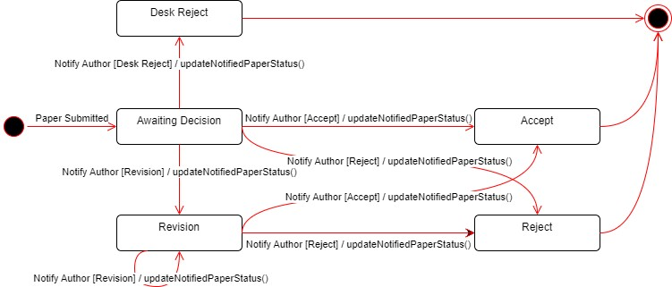
Notified Statuses State Diagram

Slide 44
Flow 2: Monitor and Manage Conference Submissions
DEMO 2.5
Initiate a Call for Research Papers
Appoint Paper Reviewers
Finalize Paper Decisions
Communicate Decision Results
Run scripts:
Set app's date in simulation: 16-11-2023
Decide on 25 papers
Set up sample templates for notification for the [SRC] conference
Phase | Deadline Name | Demo Deadline Value
Awaiting Submission Review | Review Submission Deadline | 15-11-2023
Phase | Deadline Name | Demo Deadline Value
Last Decision-Making | Last Decision-Making Deadline | 24-11-2023

Slide 45
Flow 3:
Prepare Conference Proceeding

Slide 46
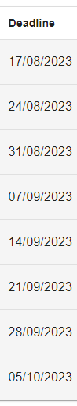
Flow 3: Prepare Conference Proceeding
Following flow 2, Conference Proceeding Preparation involves crafting manuscripts (a list of submissions) expected to appear in the conference proceeding.
Conference Management Tasks include
Request Camera Ready
Request Presentation
Produce Reports
PREPARE CONFERENCE PROCEEDING
Chairman
Authors
System
2. Monitor and Manage Conference Submissions
14
Trigger
15
Request
16
Submit
Camera Ready
Camera Ready
17
Register
Admin
System
Authors
Chairman
System
21
Produce
20
Submit
19
Request
18
Report
Report
Presentation
for Presentation

Slide 47
Update Notified Status
After informing the author, the results will update the Notified Status and proceed to the request camera-ready step.
Request for Camera Readies
Request Presentation Materials
Produce Statistical Summaries
PREPARE CONFERENCE PROCEEDING
Chairman
Authors
System
2. Monitor and Manage Conference Submissions
14
Trigger
15
Request
16
Submit
Camera Ready
Camera Ready
17
Register
Admin
System
Authors
Chairman
System
21
Produce
20
Submit
19
Request
18
Report
Report
Presentation
for Presentation

Slide 48
Camera Ready Request
PC Chairs initiate camera-ready requests for particular submissions. By default, accepted submissions are requested for camera-ready submission.
Request for Camera Readies
Request Presentation Materials
Produce Statistical Summaries
PREPARE CONFERENCE PROCEEDING
Chairman
Authors
System
2. Monitor and Manage Conference Submissions
14
Trigger
15
Request
16
Submit
Camera Ready
Camera Ready
17
Register
Admin
System
Authors
Chairman
System
21
Produce
20
Submit
19
Request
18
Report
Report
Presentation
for Presentation

Slide 49
Flow 3: Prepare Conference Proceeding
DEMO 3.1
Request for Camera Readies
Request Presentation Materials
Produce Statistical Summaries
Run scripts:
Request Camera Ready by the [Camera Ready Bulk Enable] option

Slide 50
[Author] Camera Ready Submission
When submissions are classified as requiring camera-ready submission and the track already entered to the [Open for Camera Ready Submission] phase, the authors will submit camera ready attached with copyright file.
Request for Camera Readies
Request Presentation Materials
Produce Statistical Summaries
PREPARE CONFERENCE PROCEEDING
Chairman
Authors
System
2. Monitor and Manage Conference Submissions
14
Trigger
15
Request
16
Submit
Camera Ready
Camera Ready
17
Register
Admin
System
Authors
Chairman
System
21
Produce
20
Submit
19
Request
18
Report
Report
Presentation
for Presentation

Slide 51
[Author] Paper Registration
After submitting the camera-ready version, authors register their papers in the list of submissions intended for the conference proceedings.
Request for Camera Readies
Request Presentation Materials
Produce Statistical Summaries
PREPARE CONFERENCE PROCEEDING
Chairman
Authors
System
2. Monitor and Manage Conference Submissions
14
Trigger
15
Request
16
Submit
Camera Ready
Camera Ready
17
Register
Admin
System
Authors
Chairman
System
21
Produce
20
Submit
19
Request
18
Report
Report
Presentation
for Presentation

Slide 52
Camera Ready and Registration Monitoring
The PC Chairs' [Manuscripts] console will receive continuous updates regarding camera-ready submission and registration status.
Request for Camera Readies
Request Presentation Materials
Produce Statistical Summaries
PREPARE CONFERENCE PROCEEDING
Chairman
Authors
System
2. Monitor and Manage Conference Submissions
14
Trigger
15
Request
16
Submit
Camera Ready
Camera Ready
17
Register
Admin
System
Authors
Chairman
System
21
Produce
20
Submit
19
Request
18
Report
Report
Presentation
for Presentation

Slide 53
[Author] Camera Ready Submission and Registration
DEMO 3.2
Request for Camera Readies
Request Presentation Materials
Run scripts:
Set app's date in simulation: 25-11-2023
Submit 12 camera readies
Register for 5 papers
Produce Statistical Summaries
Phase | Deadline Name | Demo Deadline Value
Last Decision-Making | Last Decision-Making Deadline | 24-11-2023
Phase | Deadline Name | Demo Deadline Value
Open for Camera Ready Submission | Camera Ready Submission Deadline | 1-12-2023

Slide 54
Request for Presentation
The Chairperson requests presentations for desired submissions, either at the very end of the [Open for Camera Ready Submission] phase or at the very beginning of the [Open for Presentation Submission] phase. The default selection for requested presentations includes the successfully registered submissions.
Request for Camera Readies
Request Presentation Materials
PREPARE CONFERENCE PROCEEDING
Chairman
Authors
System
Produce Statistical Summaries
2. Monitor and Manage Conference Submissions
14
Trigger
15
Request
16
Submit
Camera Ready
Camera Ready
17
Register
Admin
System
Authors
Chairman
System
21
Produce
20
Submit
19
Request
18
Report
Report
Presentation
for Presentation

Slide 55
Flow 3: Prepare Conference Proceeding
DEMO 3.3
Request for Camera Readies
Request Presentation Materials
Produce Statistical Summaries
Run scripts:
Request Presentation through the [Presentation Bulk Enable] option.

Slide 56
[Author] Presentation Submission
When submissions are requested for presentation, authors are required to submit the presentation and specify the author(s) designated as presenters.
Request for Camera Readies
Request Presentation Materials
Produce Statistical Summaries
PREPARE CONFERENCE PROCEEDING
Chairman
Authors
System
2. Monitor and Manage Conference Submissions
14
Trigger
15
Request
16
Submit
Camera Ready
Camera Ready
17
Register
Admin
System
Authors
Chairman
System
21
Produce
20
Submit
19
Request
18
Report
Report
Presentation
for Presentation

Slide 57
[Author] Presentation Submission
DEMO 3.4
Request for Camera Readies
Request Presentation Materials
Run scripts:
Set app's date in simulation: 2-12-2023
Submit 5 presentations
Produce Statistical Summaries
Phase | Deadline Name | Demo Deadline Value
Open for Camera Ready Submission | Camera Ready Submission Deadline | 1-12-2023
Phase | Deadline Name | Demo Deadline Value
Open for Presentation Submission | Presentation Submission Deadline | 15-12-2023

Slide 58
Produce Reports
A compilation of conference manuscripts expected to appear in the proceedings is created in the Chairman's [Manuscripts] console during the conference, and it is included in the Admin's Final Report after the conference concludes.
Request for Camera Readies
Request Presentation Materials
Produce Statistical Summaries
PREPARE CONFERENCE PROCEEDING
Chairman
Authors
System
2. Monitor and Manage Conference Submissions
14
Trigger
15
Request
16
Submit
Camera Ready
Camera Ready
17
Register
Admin
System
Authors
Chairman
System
21
Produce
20
Submit
19
Request
18
Report
Report
Presentation
for Presentation

Slide 59
Produce Reports
DEMO 3.5
Request for Camera Readies
Request Presentation Materials
Run scripts:
Download Manuscripts [Registered Papers] report
Set app's date in simulation: 25-12-2023
Download Final Report
Produce Statistical Summaries
Phase | Deadline Name | Demo Deadline Value
Open for Presentation Submission | Presentation Submission Deadline | 15-12-2023
Phase | Deadline Name | Demo Deadline Value
End Date | End Date Deadline | 25-12-2024

Slide 60
Other Features

Slide 61
OTHER FEATURES
Conference Website Creation
Construct a package of HTML files that is prepared for deployment and includes content related to the conference for public promotional purposes. This content is sourced from the conference plan and any supplementary details provided by the admin.
Lecture Research Profile
Establish research profile pages for lecturers at FPT University, Ho Chi Minh Campus.

Slide 62
Outcome

Slide 63
VALUES
1. SRASS offers a comprehensive process that encompasses the necessary conference management activities at FPT University, Ho Chi Minh Campus.
2. SRASS presents methodologies and automated tools for efficient conference management:
2.1 Automatically tracking conference progress, accompanied by a brief overview of the process.
2.2 Enhancing integrity in scientific research by automatically detecting conflicts of interest.
2.3 Providing reviewer recommendations based on subject relevance, quotas, and conflicts of interest with submissions.
3. SRASS implements a reminder and task suggestion mechanism through the use of the "lightbulb" feature.

Slide 64
CHALLENGES
Changes to the structure of track activity timelines and revision counts CANNOT occur once this content is confirmed and submissions are received.
The processing of conference proceedings will NOT be carried out.
Currently, there is NO mobile application accessible for authors and reviewers.

Slide 65
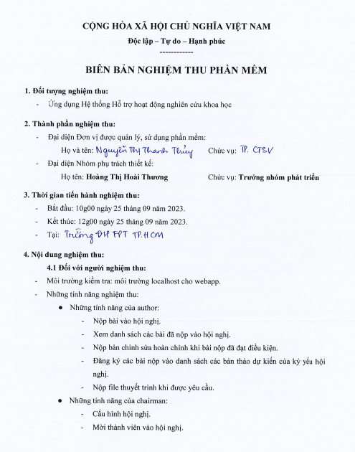
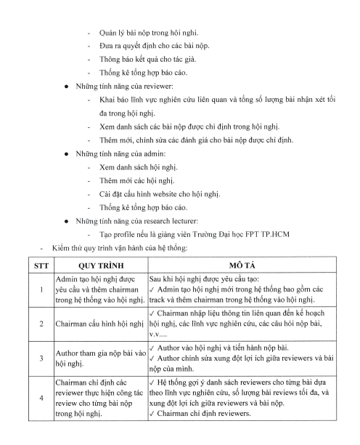
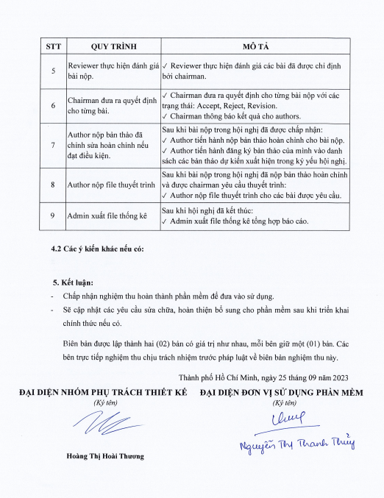
Business Confirmation

Slide 66
Thank you for listening

Slide 67
REVIEWER SUGGESTION RANKING ALGORITHM
When dealing with each submission,
Arrange the reviewers in descending order of groups (higher group index indicates stronger recommendations). Reviewers are categorized based on the following evaluation criteria:
Group 1: Reviewers with conflicts (either submission conflict or reviewer conflict) related to the submission and are already at or over their assigned quota.
Group 2: Reviewers with conflicts (either submission conflict or reviewer conflict) related to the submission but still have quota available (their assigned submissions are less than the reviewer quota).
Group 3: Reviewers without any conflicts (neither submission conflict nor reviewer conflict) related to the submission and have remaining quota.
Within each group, further sort the reviewers in descending order based on their subject area relevance scores (higher relevance scores indicate stronger recommendations)

Slide 68
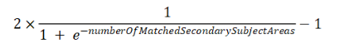
HOW SUBJECT AREA RELEVANCE SCORES ARE CALCULATED
Subject Area Relevance Score takes into account overlap between subject areas (primary, secondary) provided by reviewers and authors for their papers as follows. Higher values of relevance denote better match between a reviewer and paper. There are 4 cases of subject area overlap we considered:
Paper and reviewer exact match on Primary: pp (1 if match, 0 otherwise)
Primary subject area of reviewer matches secondary subject area of paper: ps (1 if match, 0 otherwise)
Primary subject area of paper matches secondary subject area of reviewer: sp (1 if match, 0 otherwise)
Secondary subject area of reviewer overlaps with secondary subject area of paper: ss is calculated by the formula:
The PC Chairs can configure the factor for each case, denoted as F(case).
The general formula for calculating a subject area relevance score is as follows:
By default,
F(pp) = 0.80, F(sp) = 0.16, F(ps) = 0.16, F(ss) = 0.04
Default Relevance Formula is
0.80pp + 0.16ps + 0.16sp + 0.04ss

